Slide 1

What makes an Airbnb superhost truly super?
Team 2: Hassan Abrar | Anton De Franco | Pratiksha Gupta |
Ridvan Kanca | Sahana Reddy
Notes:
Chicago and Houston were chosen because these are major cities with comparable populations
In the vicinity of two and half million
They are industrial cities
Economic hubs in US with comparable populations

Slide 2
Secondary Research

Slide 3
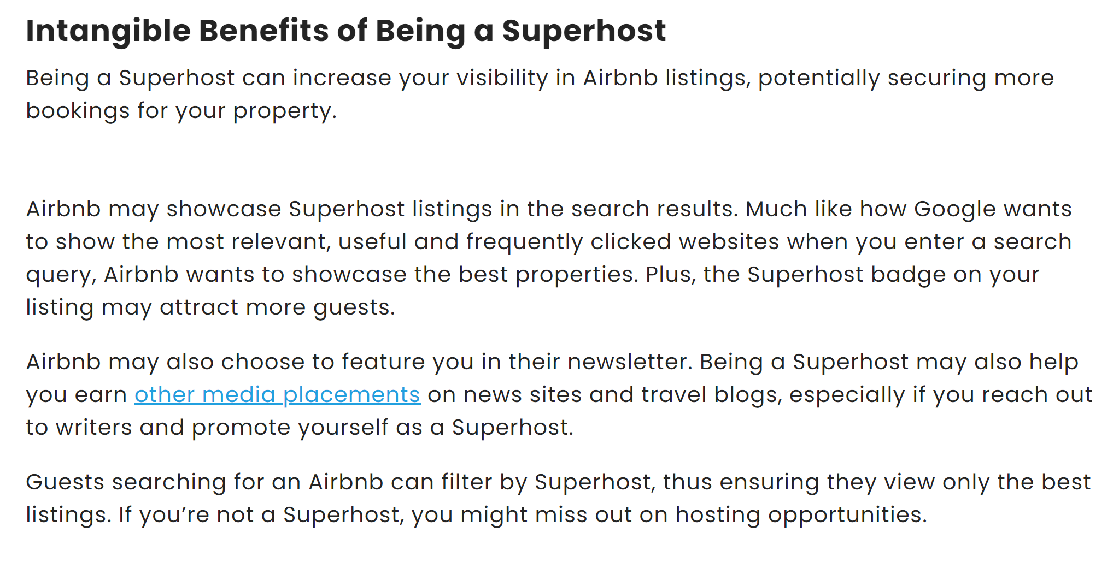
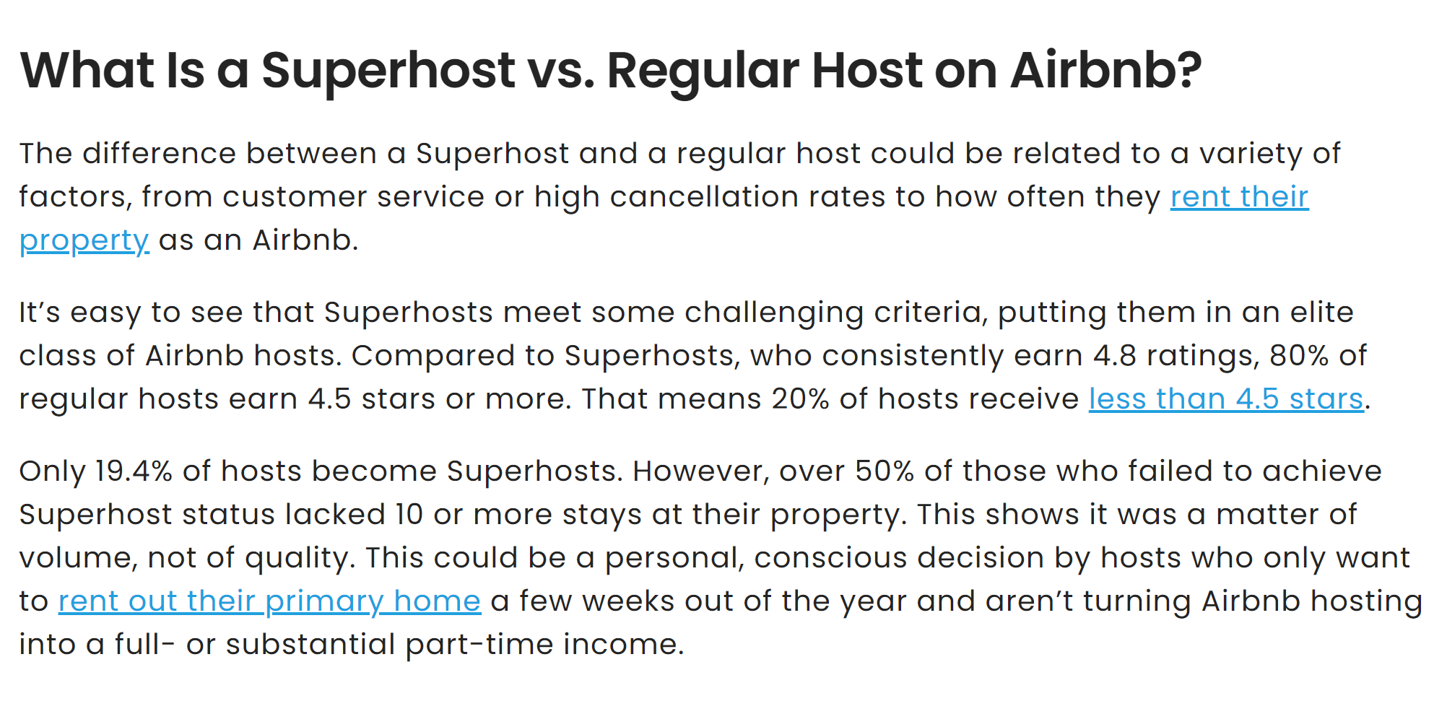
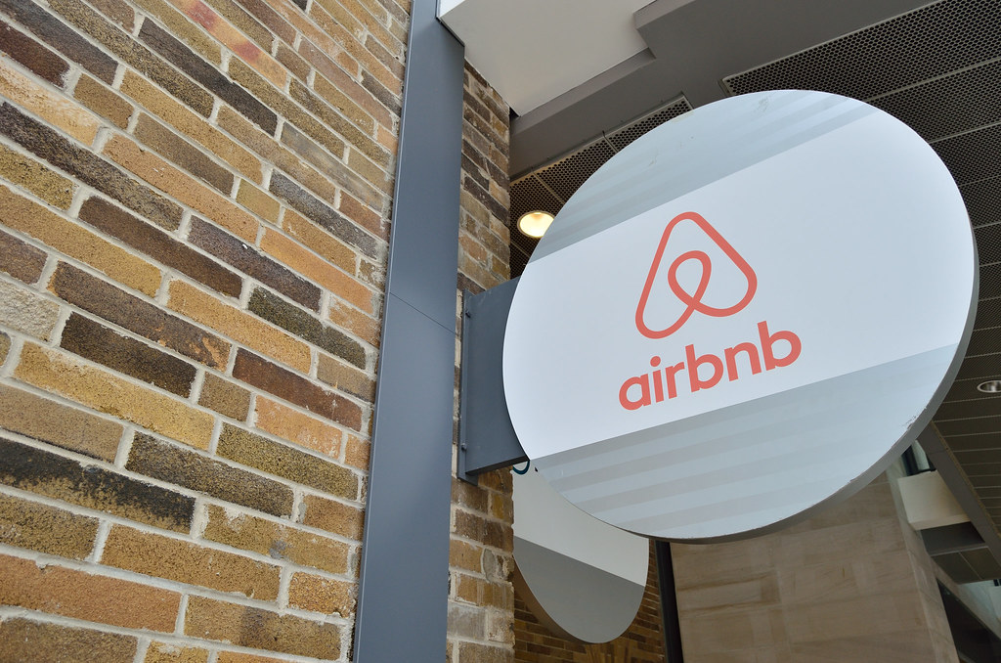
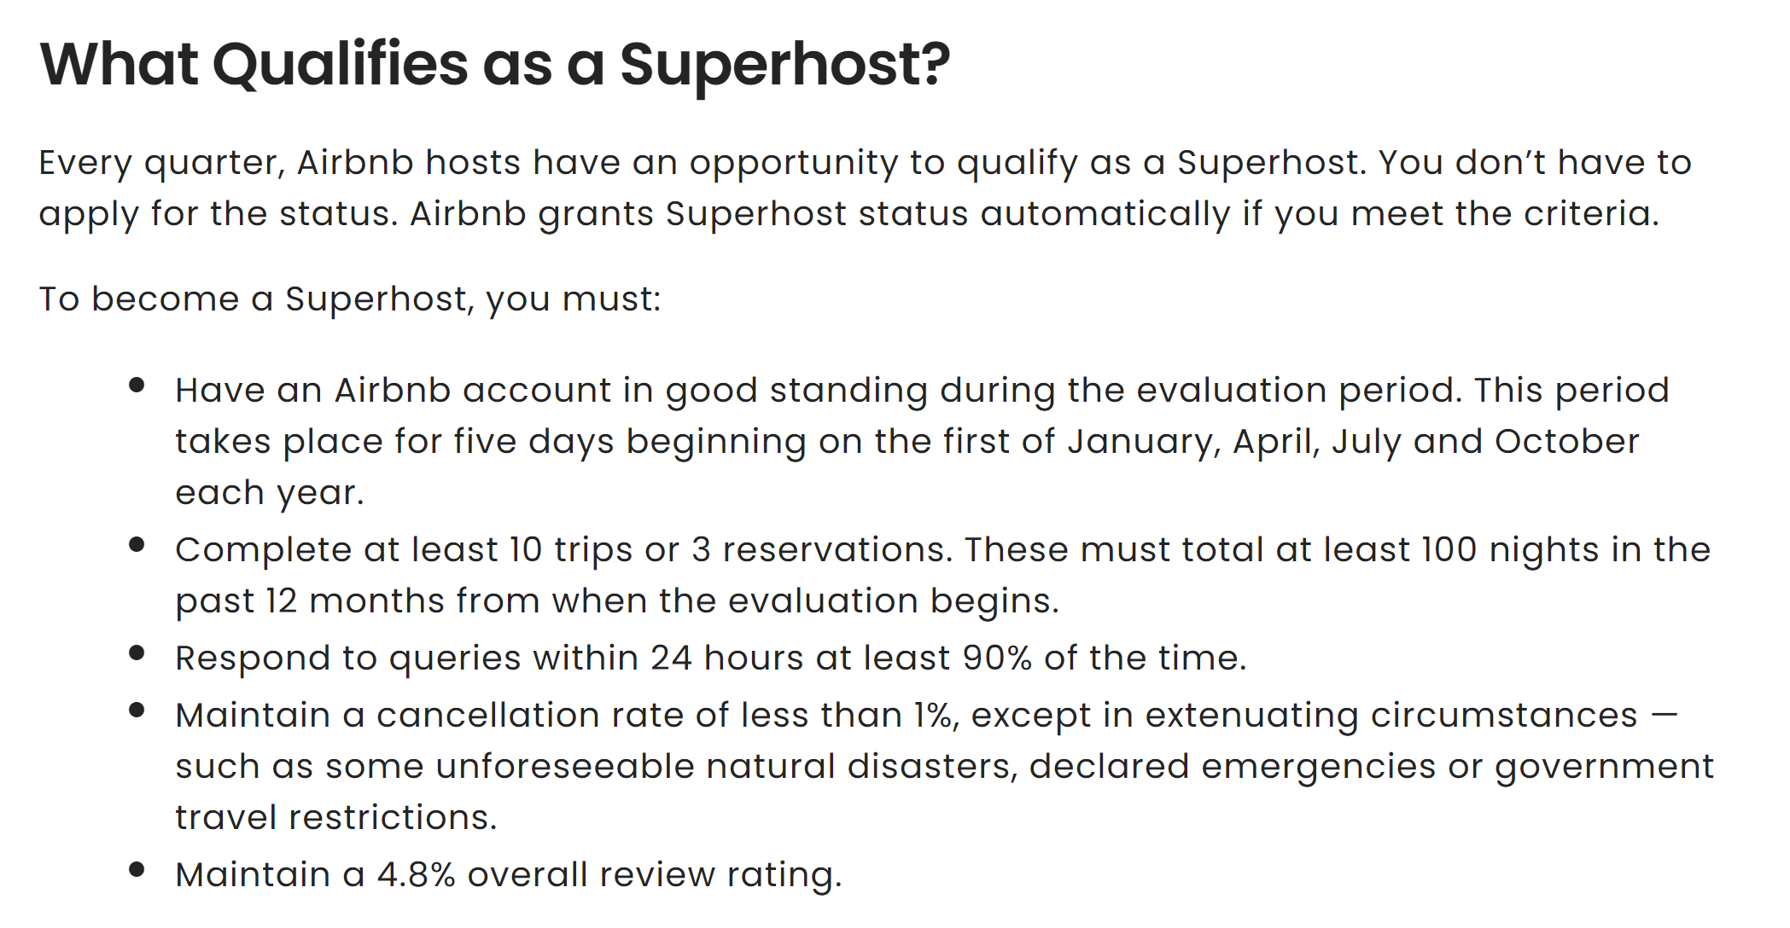
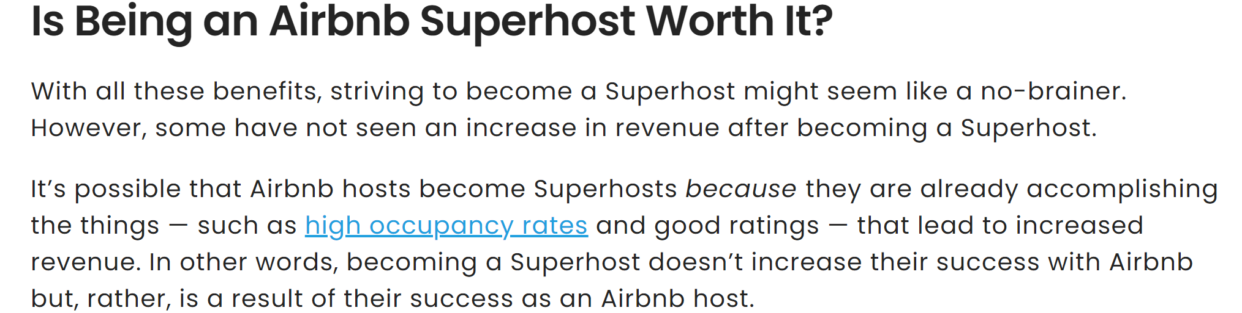
Review Articles and Journals

Slide 4
Exploratory Analysis

Slide 5
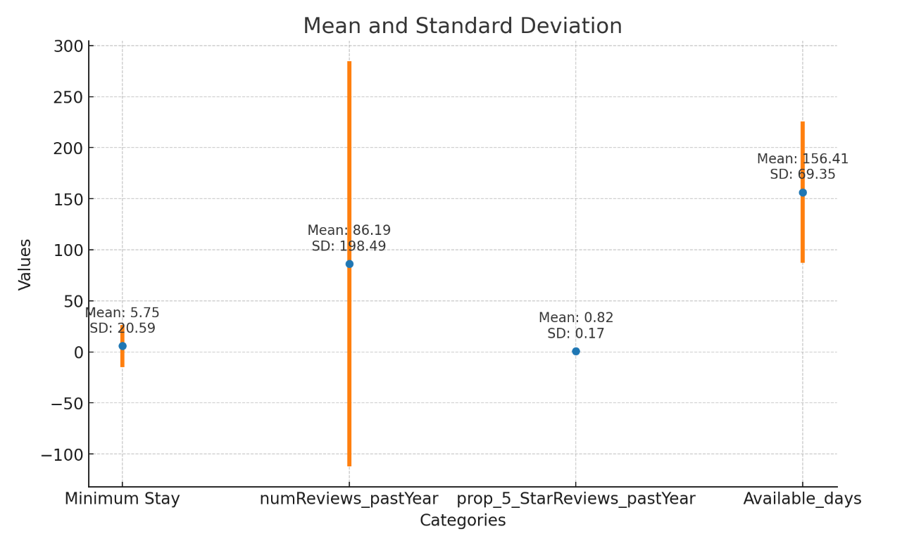
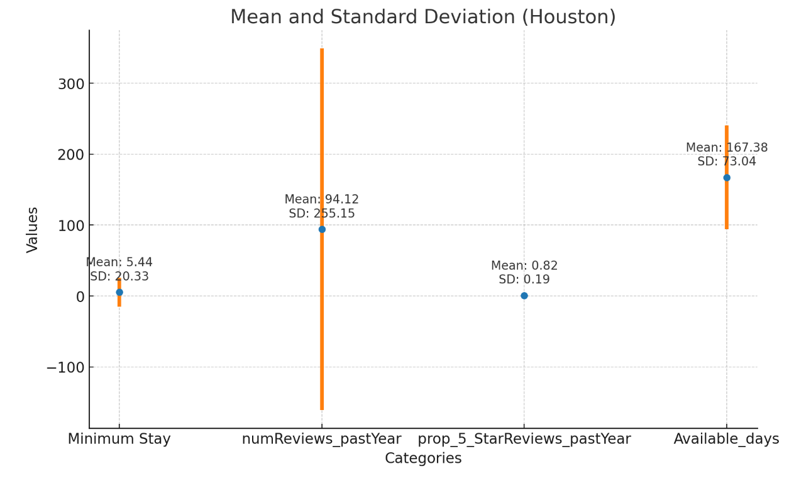
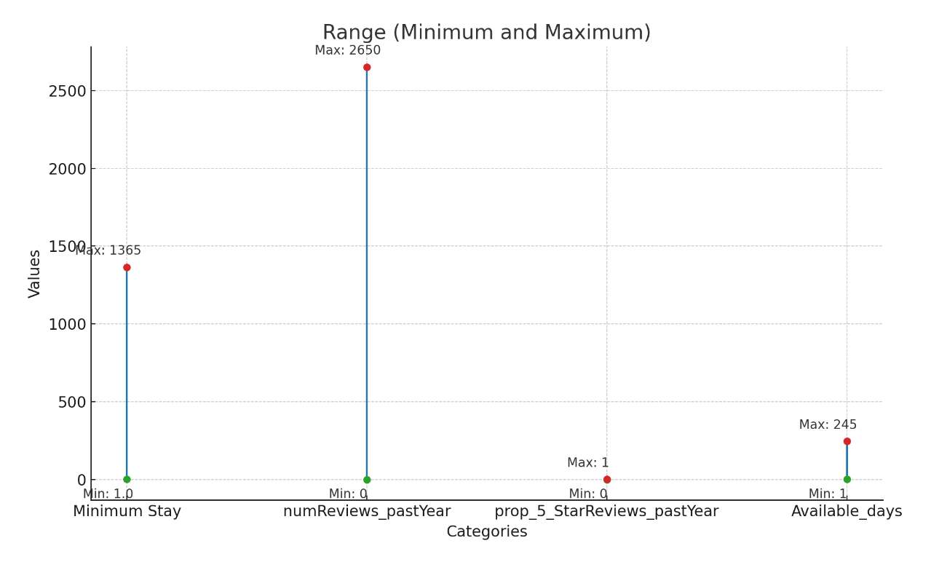
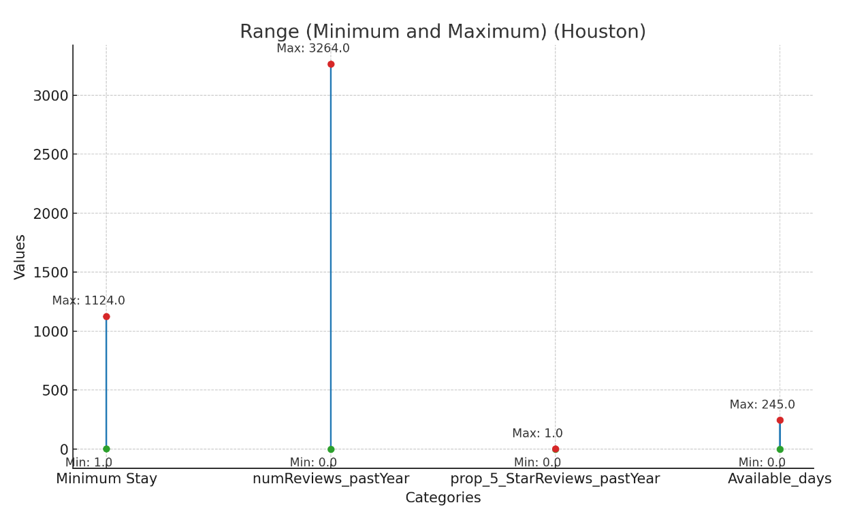
Summary Statistics
Chicago
Houston

Slide 6
Exploratory Questions
Is there potential bias against Superhosts in customer ratings and reviews?
Explore how Superhost activity clusters. Does having a Superhost in a neighborhood raise the quality of hosts in the area?
Is there a correlation between Superhosts and price?
Which properties and locations are more likely to have Superhosts?
Is there a correlation between minimum night stay requirements and Superhost status?
Is there a correlation between availability and Superhost status?

Slide 7
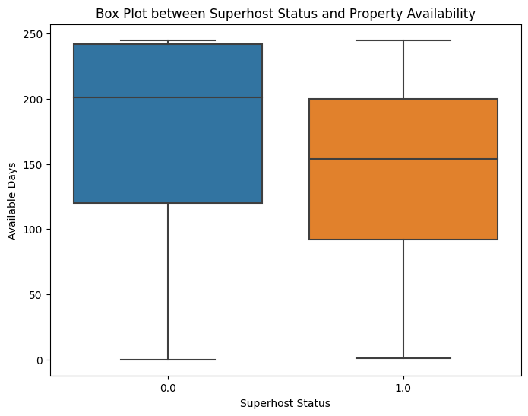
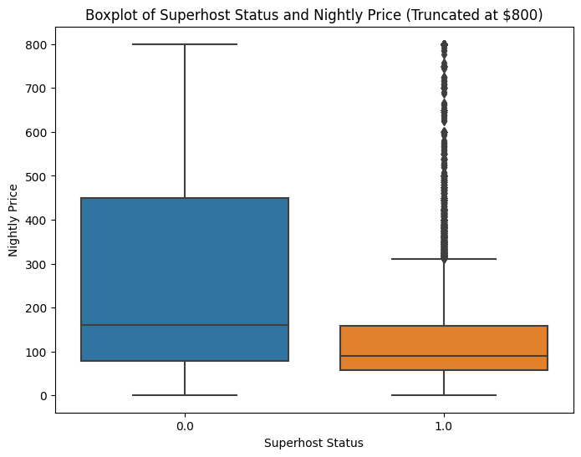
Superhosts and Price/Availability
Airbnb Superhosts tend to be booked (i.e. have less available days) compared to normal hosts
Superhost pricing appears to be far more clustered compared to normal hosts

Slide 8
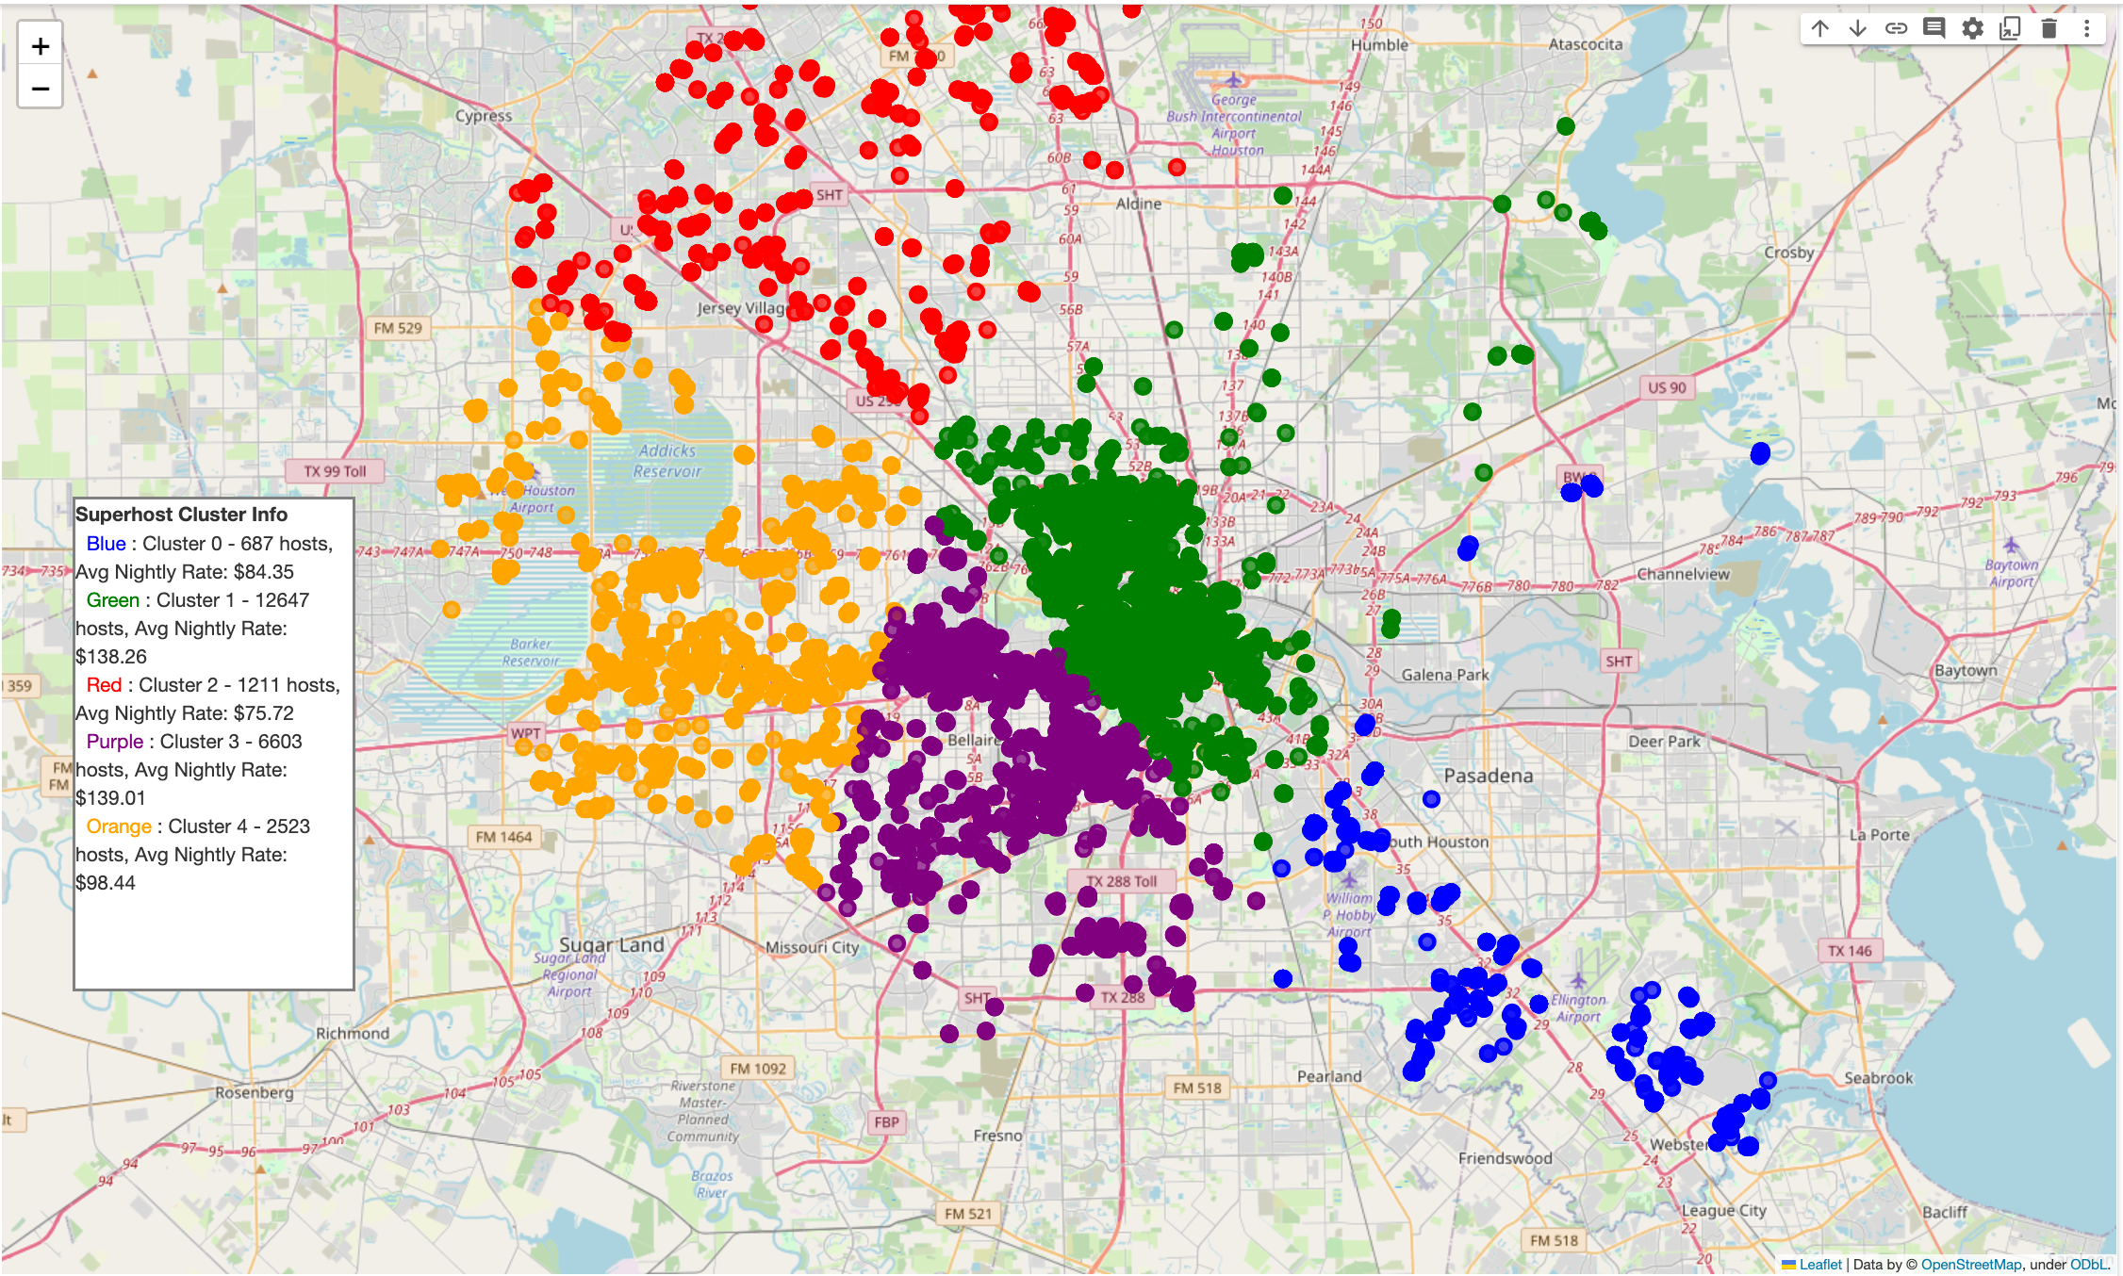
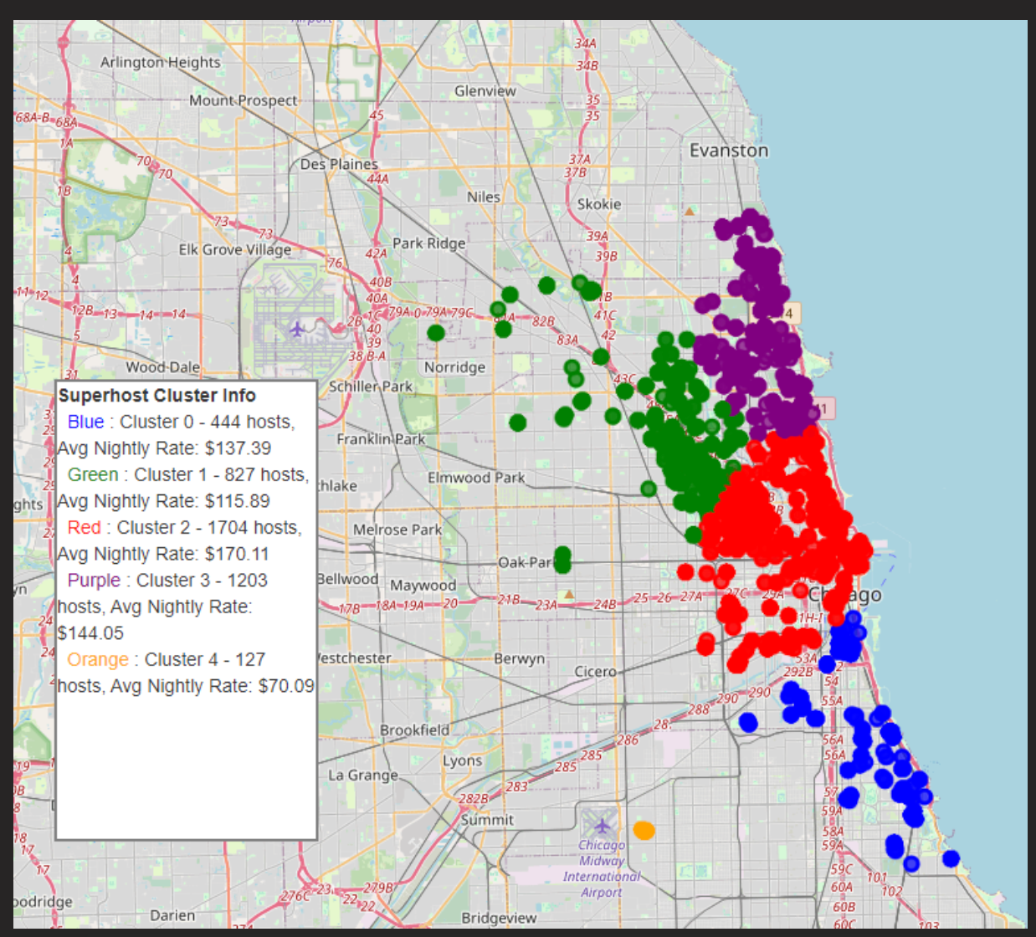
Clustering of Superhost Activity
Houston
There are more superhosts around city centers for both Houston and Chicago
Superhosts average prices tend to be higher around city centers but closer to each other
Average nightly rate for superhosts in Chicago is higher than Houston with a highest average nightly rate in Houston is $139.01 while it is $170.11 in Chicago
Chicago

Slide 9
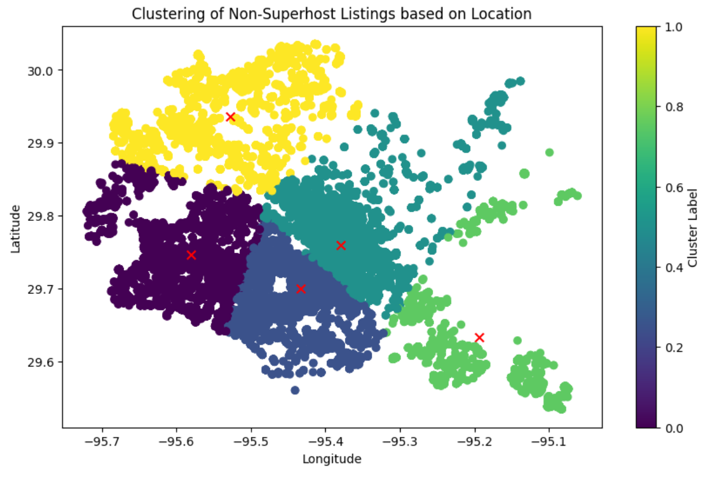
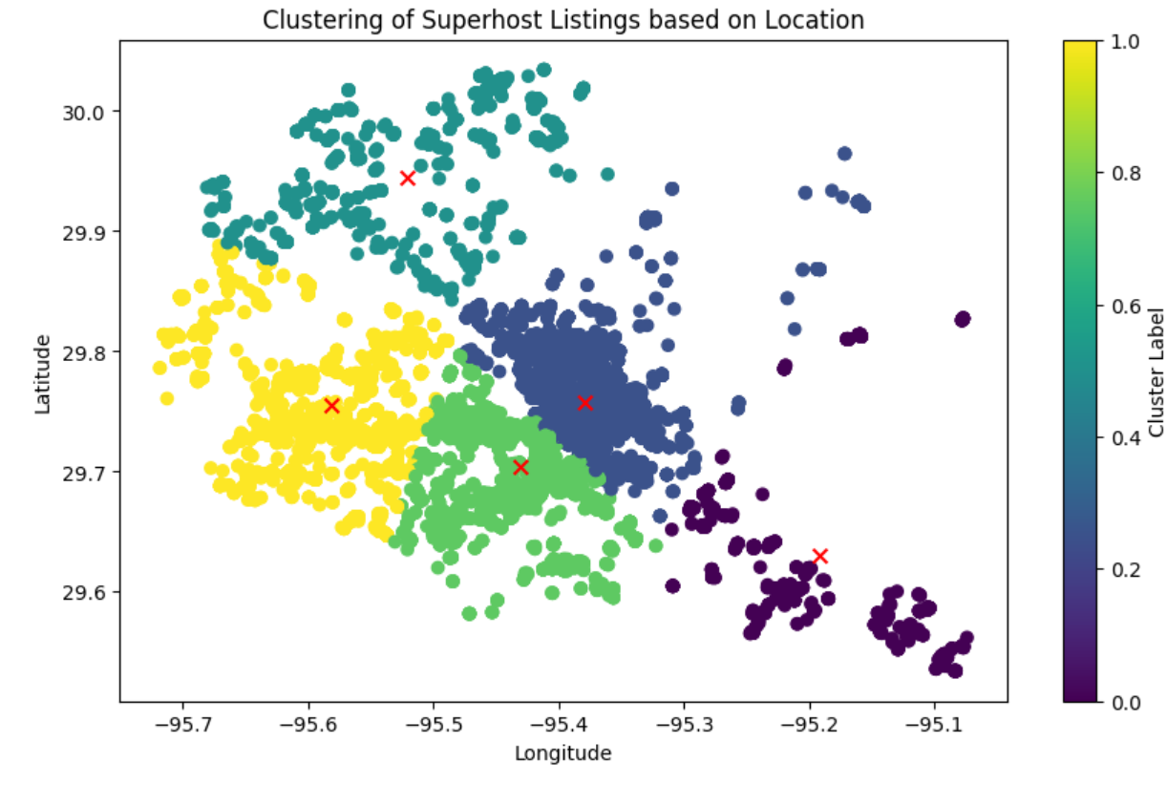
Houston Superhost vs. Non-Superhost
Superhosts density when compared with non-superhosts is quite different in Houston
Superhost density is higher in city centers

Slide 10
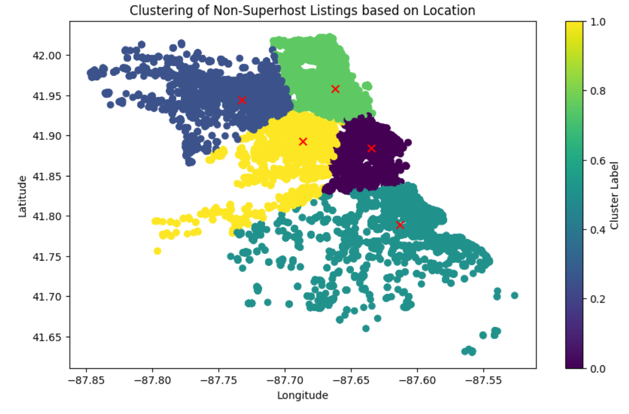
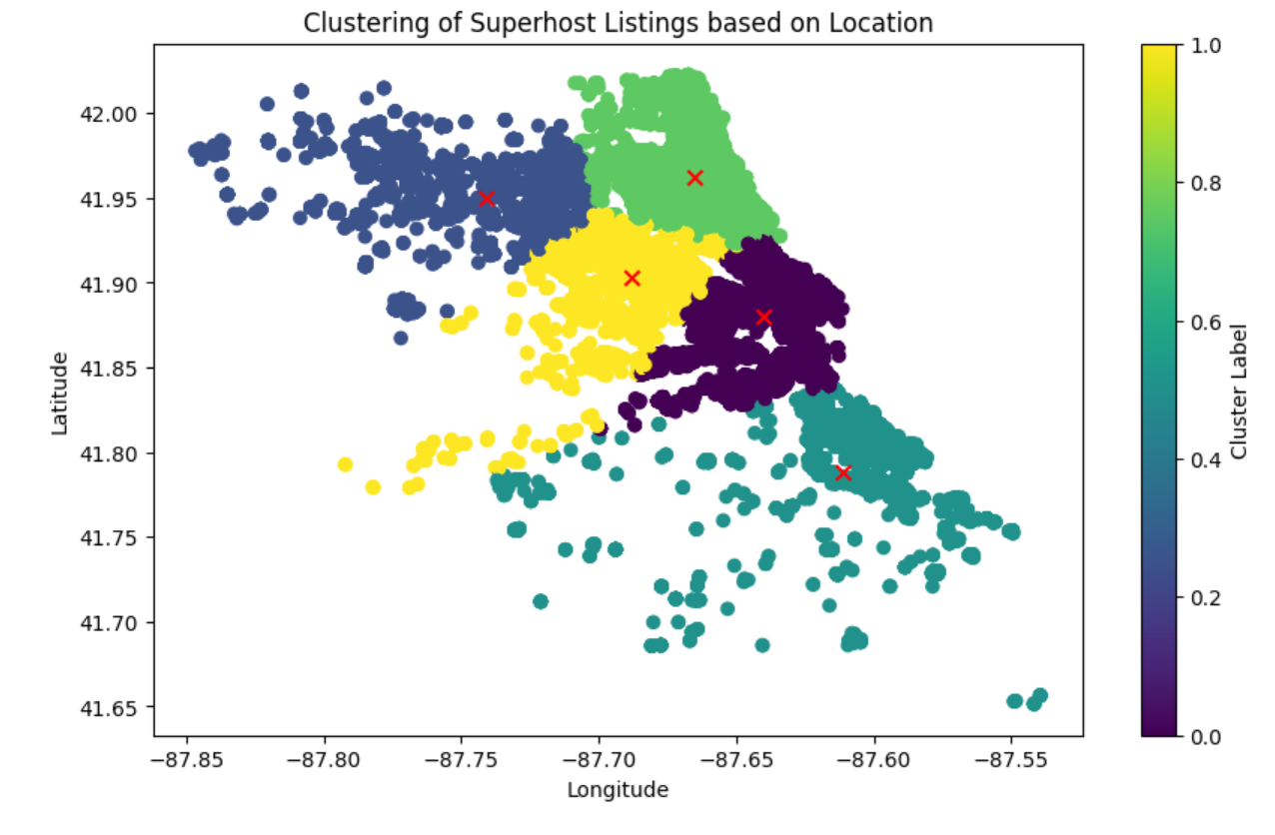
Chicago Superhost vs. Non-Superhost
Superhost density when compared with non-superhost is similar in Chicago
There are more superhost density in Chicago when compared with Houston
It can be assumed that there are similar numbers of superhost and non-superhost in Chicago

Slide 11
Model Exploration

Slide 12
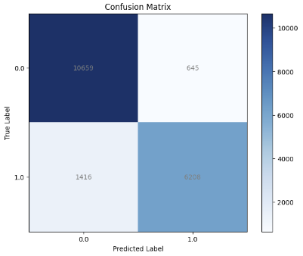
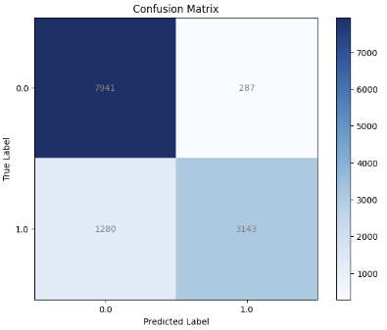
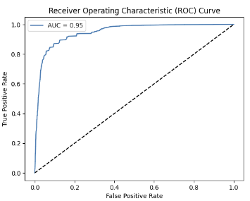
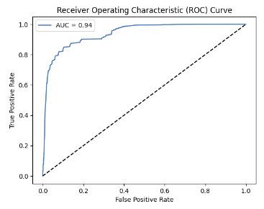
Logistic Regression
Chicago
Houston
Simple to train and interpret
AUC was 0.95 for Chicago and 0.94 for Houston
However, ROC curves are oddly shaped and suggests model instability
Overfitting
Poor convergence
Notes:
Oddly shaped roc curve
Data inconsistency?
Model instability: this could be due to issues like overfitting or poor convergence during training.

Slide 13
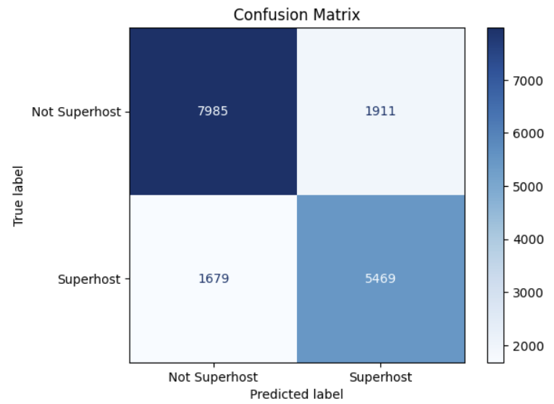
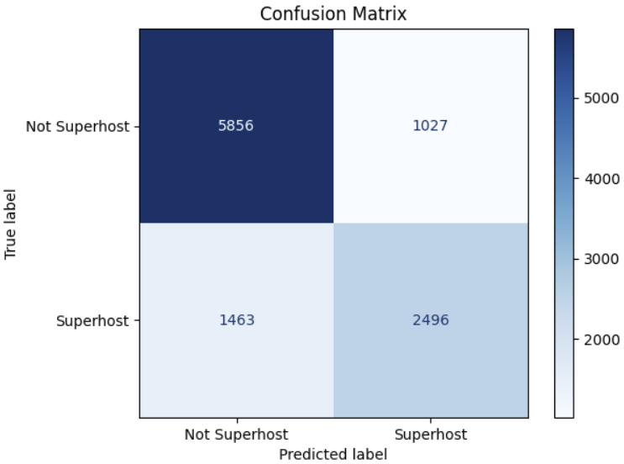
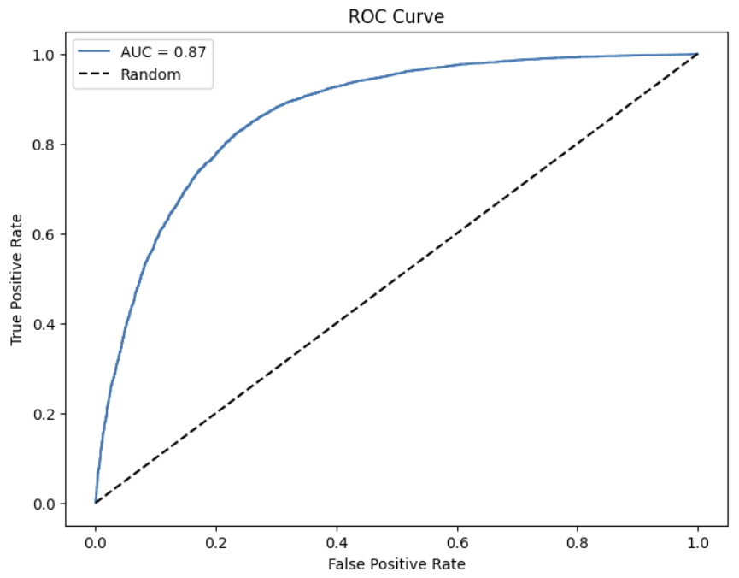
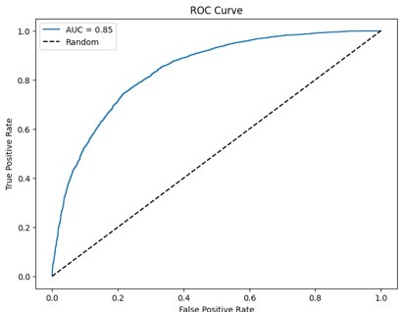
Neural Network
Chicago
Houston
Strong ROC curve but did not perform as well as our best model
Attempted basic hyperparameter tuning
Learns from data to improve performance
Long training and run time
Best Parameters | Layers | Neurons | Dropout Rate
 | 3 | 128 | 0.3
Notes:
Oddly shaped roc curve
Data inconsistency?
Model instability: this could be due to issues like overfitting or poor convergence during training.

Slide 14
Final Model

Slide 15
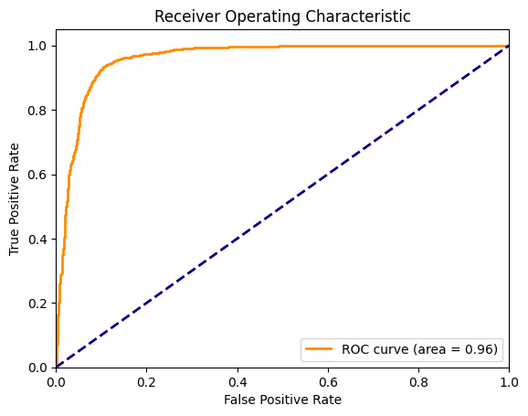
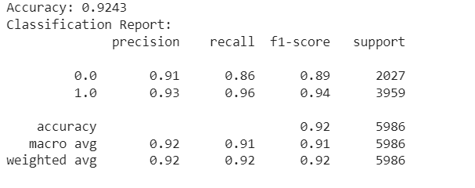
Ensemble Model (Final Model)
Utilized scikit-learn's VotingClassifier to combine predictions from multiple base classifiers (Logistic Regression, Random Forest, Gradient Boosting).
Pre-processing steps:
Remove outliers
Split the data into an 80/20 split
Replaced missing numerical with the mean
Scaled applicable variables

Slide 16
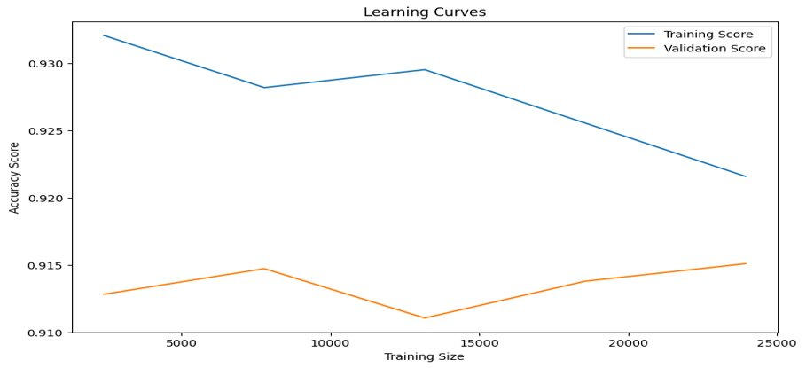
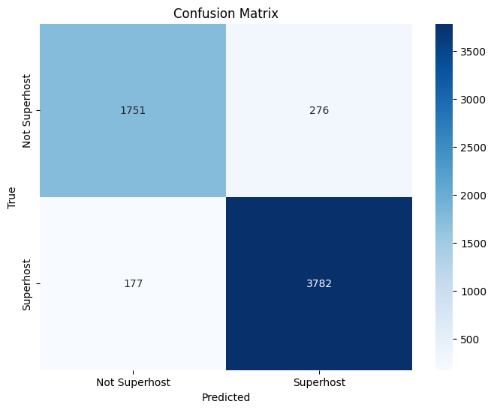
Final Model Overfitting Checks
We performed Cross-validation to test the robustness of our model (N=5) and achieved an average accuracy of 0.915
As the size of the training set increases, the test and validation accuracy begins to converge
TP
FN
FP
TN

Slide 17
Business Insights

Slide 18
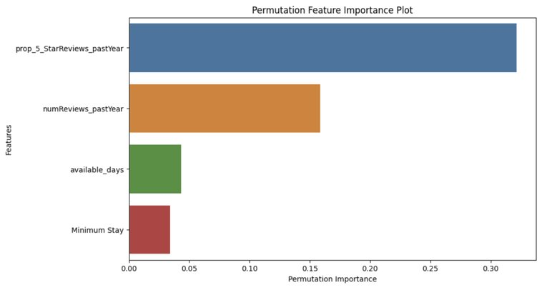
Key Performance Indicators for attaining and maintaining Superhost status
Increasing the number of 5 star reviews and reviews overall is the most important feature to be a Superhost
Increasing the number of available days increases likelihood of becoming a Superhost for the next period
Low minimum stay requirements also increases probability of becoming a superhost
Some of the key indicators align with the evaluation criteria as mentioned in the dataset, however, reviews and ratings win emphatically as the deciding factor compared to all others .
Notes:
Elevating 5-star reviews and increasing overall review frequency emerges as pivotal factors: Our research underlines that a significant surge in 5-star reviews and a consistent growth in the overall review count significantly enhance the likelihood of attaining Superhost status.
Expanded Availability Yields Superhost Potential: We discovered a positive correlation between increasing the number of available days for bookings and the probability of becoming a Superhost in the subsequent period. This underscores the importance of offering extended availability for guests.
Embracing Flexibility with Minimum Stay Requirements: Interestingly, our analysis showcases that maintaining lower minimum stay requirements also contributes positively to the likelihood of achieving Superhost status. This flexibility seems to play a significant role in host evaluation criteria.

Slide 19
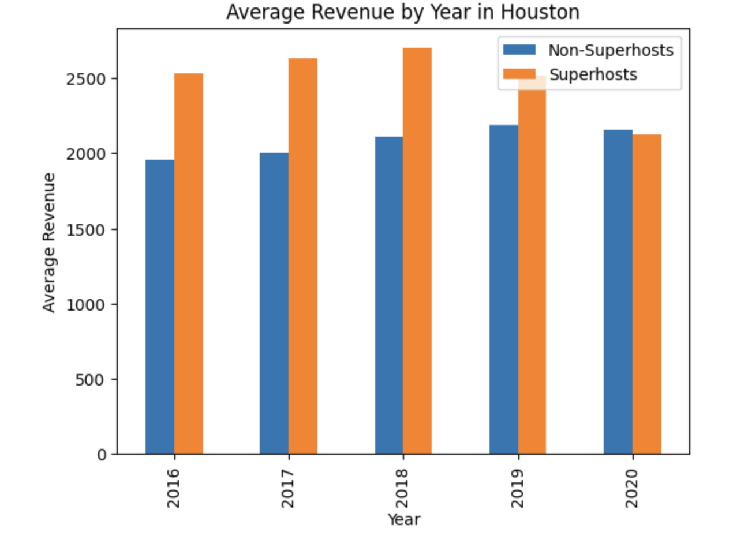
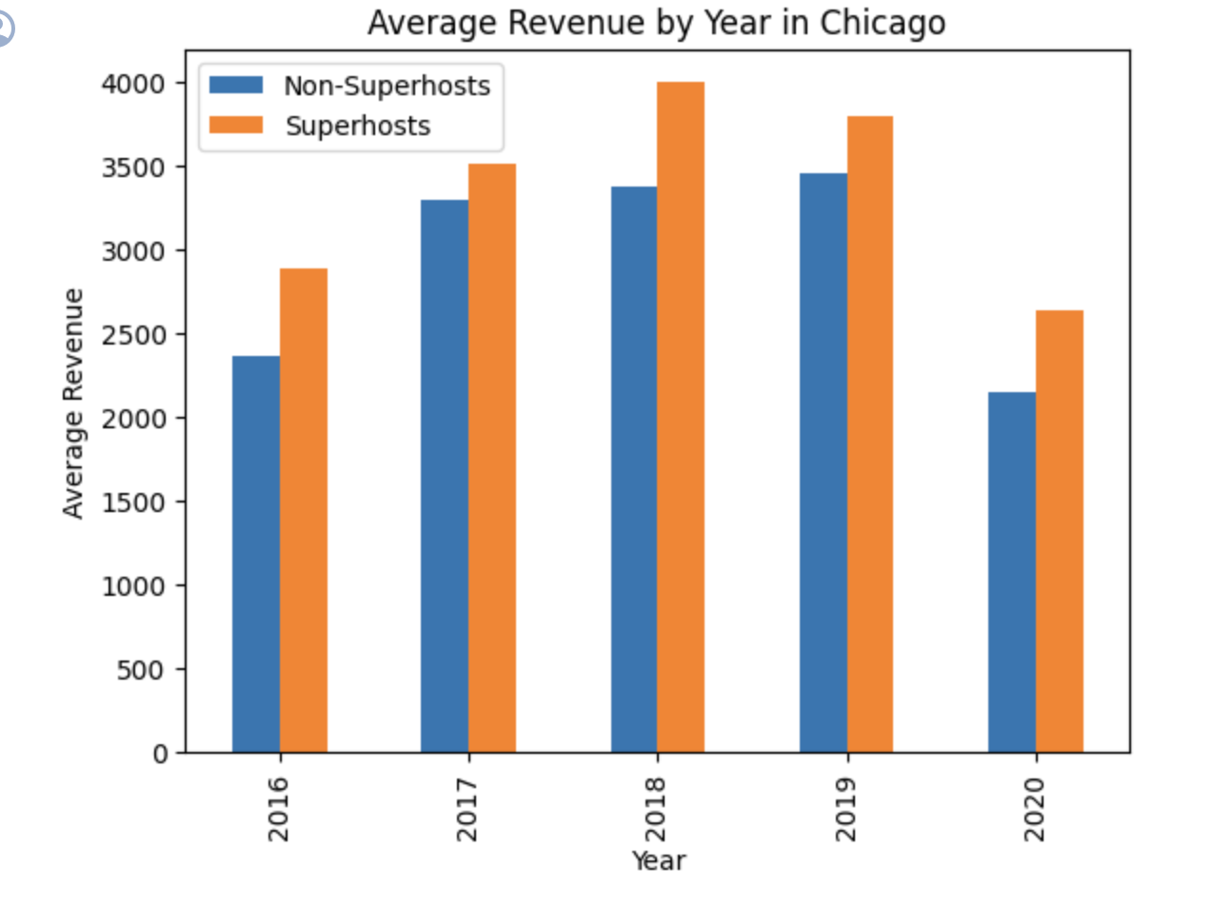
Average Increase in Revenue
It is observed that average revenue of a airbnb host for each year is greater in case he/she is designated as Superhost compared to a host
The statistics imply the same for houston as well as chicago
In essence, becoming a Superhost can translate into a profit making proposition for someone looking to enter airbnb business or for an existing airbnb host.
It is seen there is some difference w.r.t data for 2020 but that can be attributed to covid year.

Slide 20
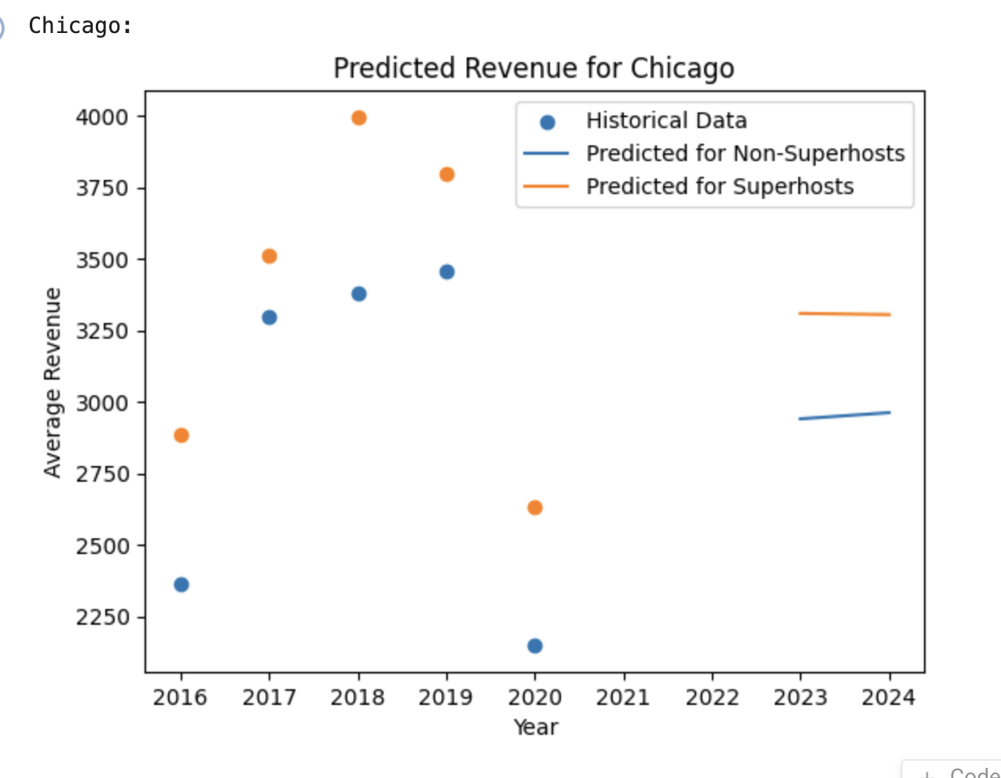
Prediction for Superhost revenue for Chicago for the year 2023 and 2024
It is seen that Superhosts will consistently earn higher than hosts which align with the understanding that hosts should focus on becoming Superhosts for higher revenue

Slide 21
Thank you

Slide 22
Appendix
Supporting Materials and Research Links

Slide 23
Secondary Research

Slide 24
Interesting Insights from Literature Review
Hosts Incur a number of Risks:
Property damage
Negative reputation arising from external effects such as noise or litter that that their neighbors have to bear.
Losing goodwill with home-owners associations and other advocacy groups that either disapprove of peer-to-peer network accommodation or resent the external effects of guests in their local neighborhoods.
Risk legal proceedings and fines in contexts in which subletting or renting out accommodation is a grey area or subject to legal restrictions
Superhost status is widely considered a badge of quality
Reviews are everything for superhosts!
Legal action taken by visitors against superhosts or Airbnb is quite tedious
The big headline is a new "Guest Favorites" feature meant to highlight outstanding homes and rooms on the platform
The Guest Favourite is more linked to the property rather than the host, is an overlap very likely though?

Slide 25
Research Articles
1. AIRBNB DISRUPTIVE BUSINESS MODEL INNOVATION: ASSESSING THE IMPACT ON HOTEL INDUSTRY Makhmoor Bashir* and Rajesh Verma**
https://www.researchgate.net/profile/Makhmoor-Bashir/publication/306193997_Airbnb_disruptive_business_model_innovation_Assessing_the_impact_on_hotel_industry/links/5b06460ca6fdcc8c2522ac1e/Airbnb-disruptive-business-model-innovation-Assessing-the-impact-on-hotel-industry.pdf
2. How Airbnb Creates Value Stephan Reinhold, Research Center for Tourism and Transport (T&T IMP-HSG), the University of St. Gallen, Switzerland Sara Dolnicar, Department of Tourism, UQ Business School, The University of Queensland, Australia
https://library.oapen.org/bitstream/handle/20.500.12657/30986/1/640674.pdf#page=50

Slide 26

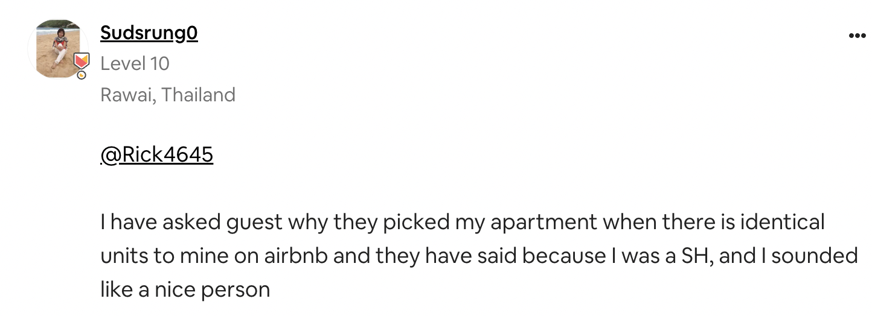
Online Research
Is superhost status worth it ?
https://community.withairbnb.com/t5/Ask-about-your-listing/Airbnb-Superhost-Status-Is-It-Really-Worth-It/td-p/1725829
Let's see what airbnb hosts/superhosts say ...

Slide 27
Exploratory Analysis

Slide 28
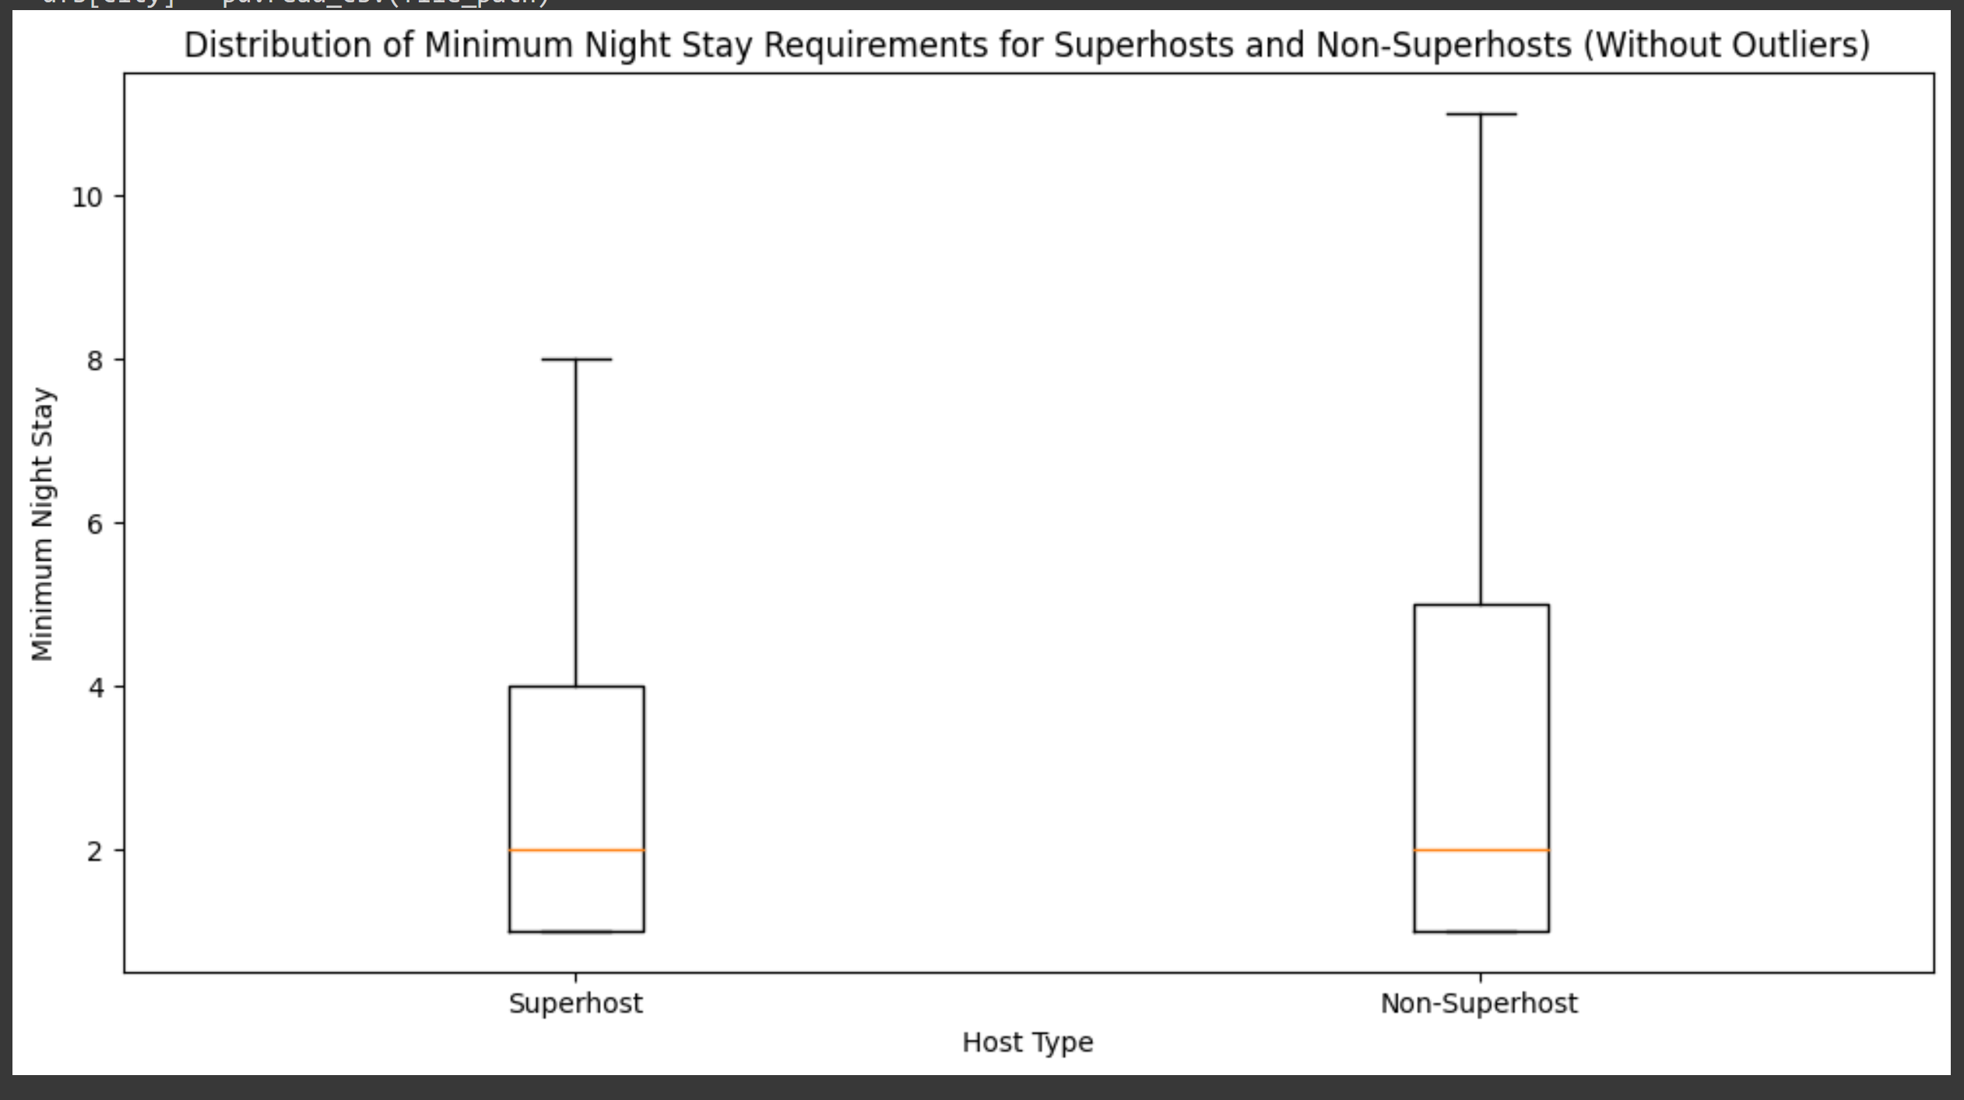

Slide 29
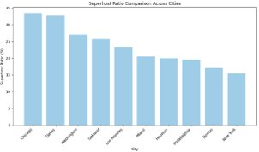
Ratio of Superhosts to All Hosts Across U.S. Cities

Slide 30
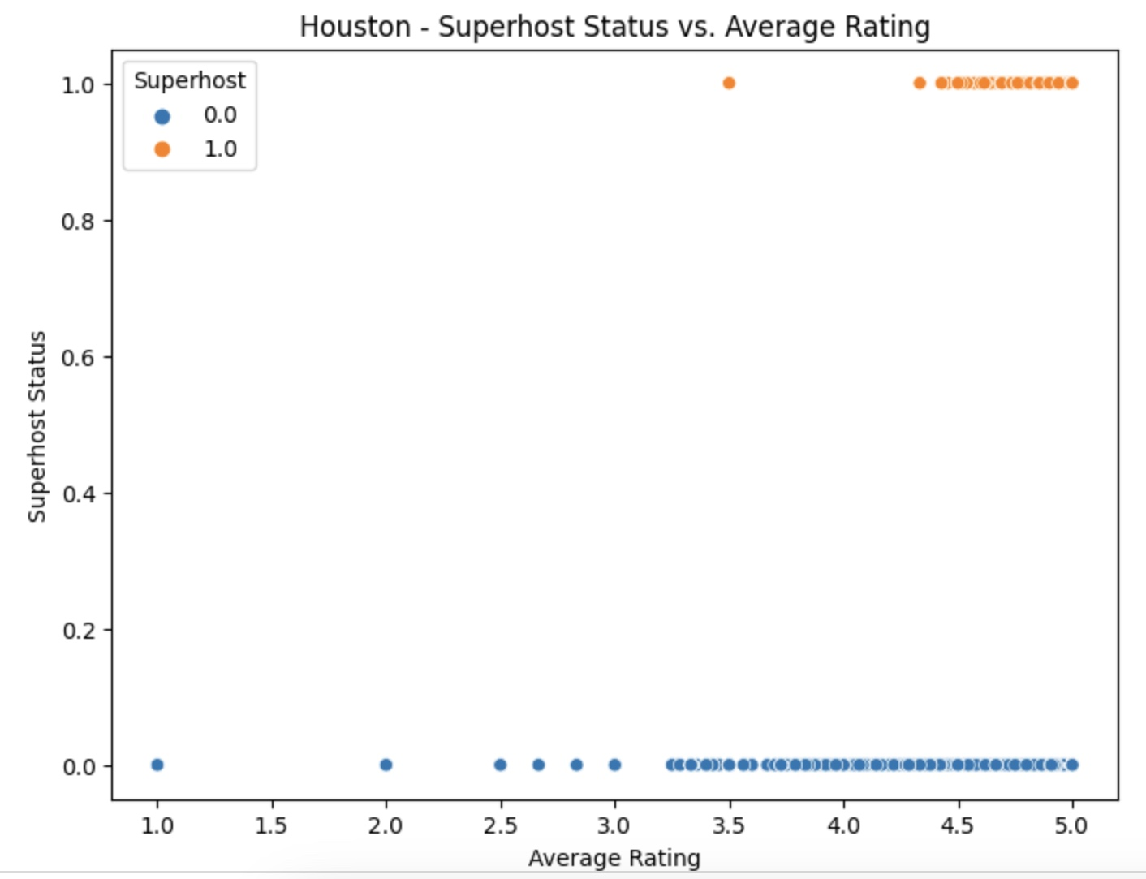
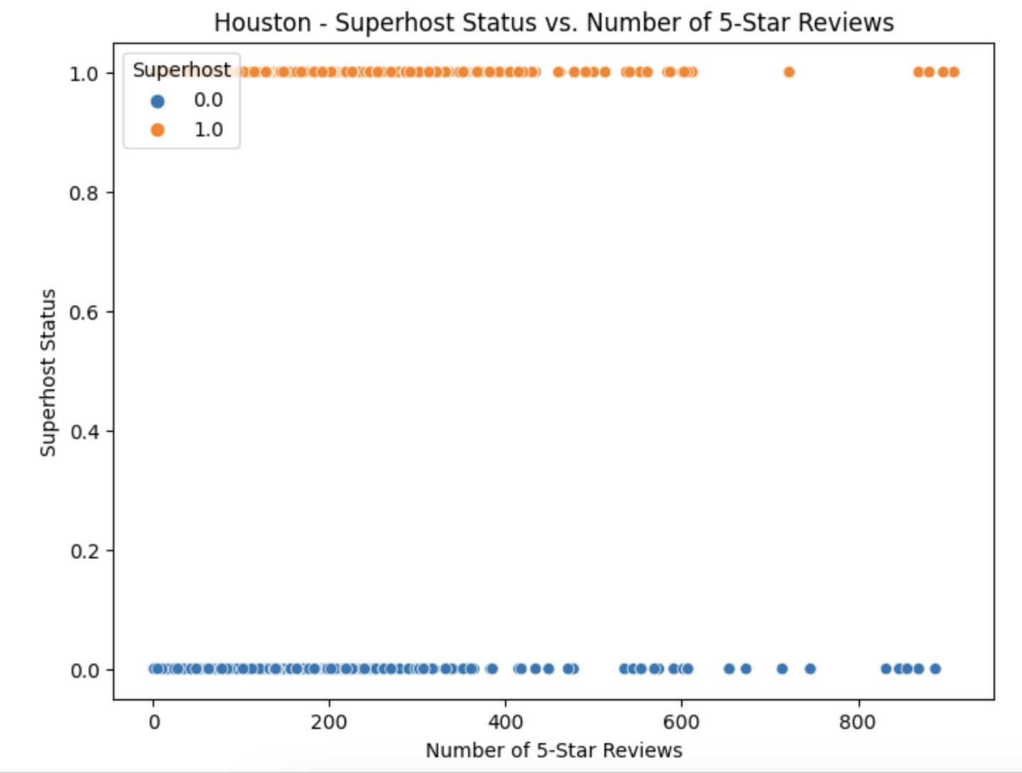
Is there a bias against Superhosts for reviews and ratings in Houston?

Slide 31
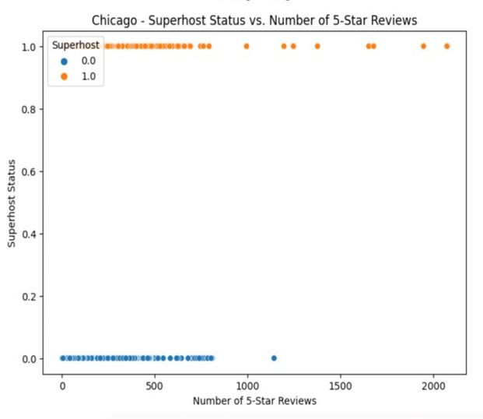
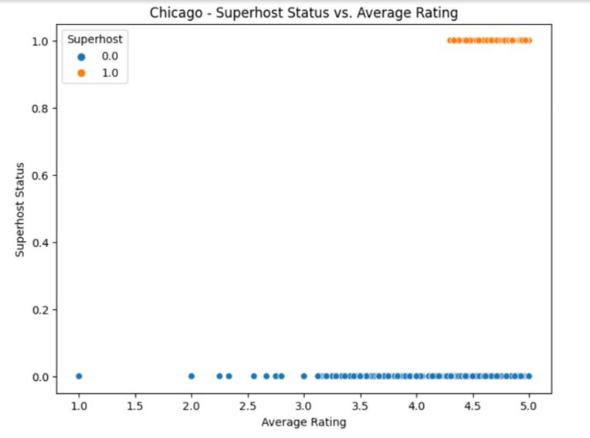
Is there a bias against Superhosts for reviews and ratings in Chicago ?

Slide 32
Final Model

Slide 33
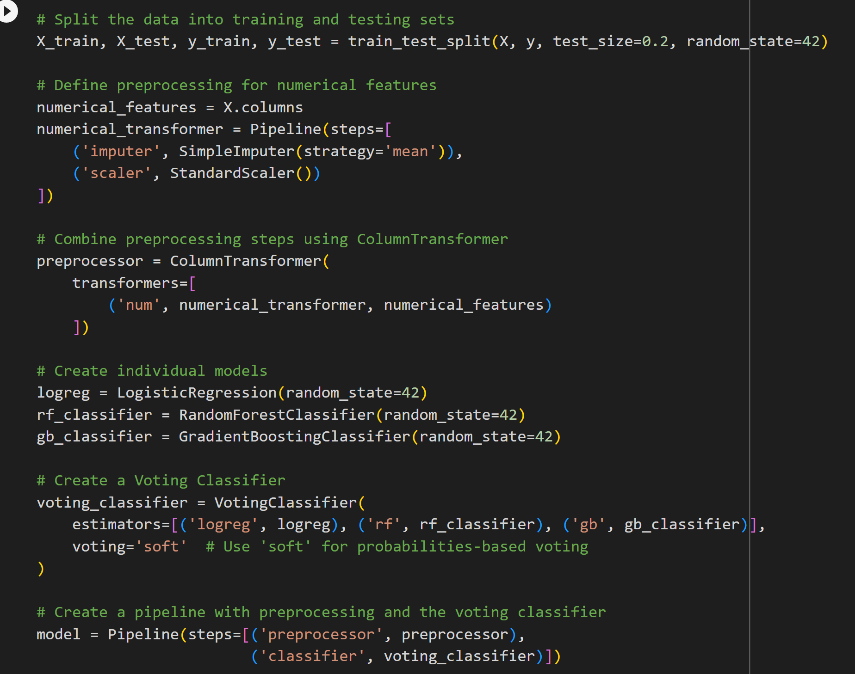
Ensemble Model- Points to note
Utilized scikit-learn's VotingClassifier to combine predictions from multiple base classifiers (Logistic Regression, Random Forest, Gradient Boosting).
Applied preprocessing steps, including imputation and scaling, using scikit-learn's ColumnTransformer and Pipeline

Slide 34
Evaluation and Visualization
Split the data into training and testing sets.
Trained the ensemble model on the training set and evaluated its performance on the test set.
Visualized the results using a confusion matrix, precision-recall curve, ROC curve, and feature importance plot to gain insights into model performance and interpretability.

